Slide 1

Initial Investigation
Steps I follow
Step1 - technical” SEO audit (which you can do with almost any SEO site audit tool).
Ex: Moz, PageSpeed Insights, gtmetrix etc.
-The aim is to provide a comprehensive approach to auditing your website from an SEO perspective. This means auditing your rankings, backlink profile, existing content… anything that could be hindering your search performance.
Step 2 - check that only one version of your site is browsable Meaning its should be SSL enabled sites.
Its should be
https://www.motomachines.com/
http://www.motomachines.com/ if it automatically redirects to the HTTPS version. Then Note: Test a couple of other URLs on your site to make sure that the 301 redirects are implemented.

Slide 2
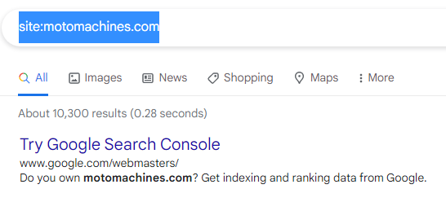
Initial Investigation
Step 3 - Start a website crawl
An SEO crawler will spider the site in the same way as Google and give us some useful information on the structure and current SEO setup. Ex: SureOak, Seochecker
Step 4 - Check Google for indexation issues
Google Search Console > Google Index > Index Status.
In this case its not there then
Search site:motomachines.com Not accurate but its 10300

Slide 3
Initial Investigation
Step 5 - Check that you rank for your brand name
Its Coming on first organic result.
Step 6 - Manually perform some BASIC on-page SEO checks
Does the page have a well-crafted, clickable title tag – Ours title tag of optimal length (between 10 and 70 characters).
- Moto Machines: Premium Motorcycle Accessories (Length : 45)
Is there a custom meta description? Is it optimized for maximizing click-throughs? - Your page has a meta description tag however, your meta description should ideally be between 70 and 320 characters (including spaces).
Length : 327
2. Is there only one instance of the H1 tag? Is it well-optimized? - Your page does not have an H1 Header Tag.The H1 Header Tag is an important way of signaling to search engines what your content is about, and subsequently the keywords it should rank for.
3. Are sub headers (H2, H3, etc.) being used correctly? - Your page is making use multiple levels of Header Tags.

Slide 4
Initial Investigation
Step 7 - Dig deeper into more on-page issues in the crawl report
1. Keyword Consistency
- Your page's main keywords are not distributed well across the important HTML tags. Your page content should be focused on particular keywords you would like to rank for. Ideally these keywords should also be distributed across tags such as the title, meta and header tags. 2. Amount of Content
- Your page has a low volume of text content which search engines can interpret as 'thin content'. Word Count: 464
It has been well researched that higher text content volumes are related to better ranking ability in general. 3. Image Alt Attributes
You have images on your page that are missing Alt attributes. We found 77 images on your page and 31 of them are missing the attribute.Alt attributes are an often overlooked and simple way to signal to Search Engines what an image is about, and help it rank in image search results.

Slide 5
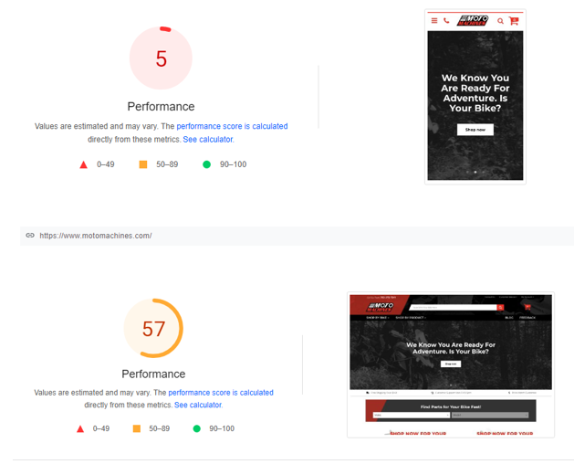
Initial Investigation
Step 7 - Dig deeper into more on-page issues in the crawl report
1. Keyword Consistency
- Your page's main keywords are not distributed well across the important HTML tags. Your page content should be focused on particular keywords you would like to rank for. Ideally these keywords should also be distributed across tags such as the title, meta and header tags. 2. Amount of Content
- Your page has a low volume of text content which search engines can interpret as 'thin content'. Word Count: 464
It has been well researched that higher text content volumes are related to better ranking ability in general. 3. Image Alt Attributes
You have images on your page that are missing Alt attributes. We found 77 images on your page and 31 of them are missing the attribute.Alt attributes are an often overlooked and simple way to signal to Search Engines what an image is about, and help it rank in image search results 4. Friendly Links
Some of your link URLs do not appear friendly to humans or search engines.We would recommend making URLs as readable as possible by reducing length, file names, code strings and special characters. Step 8 - Check that your site (and individual pages) load FAST
Google’s PageSpeed Insights Tool

Slide 6
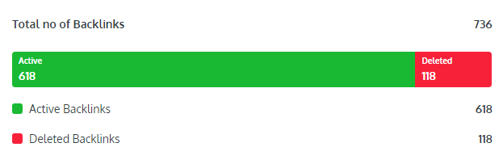
Initial Investigation
Step 9 - Analyze organic search traffic Your website traffic data will show you where your traffic is coming from, how visitors engage with your site, and what digital marketing strategies are working.
If you want to get more email subscribers, more sales for your online store, or just more traffic overall, then you need to regularly check your website analytics.
By tracking your site’s traffic, you’ll know where your site currently stands and what you can do to improve.
Tools can be used : SEMRush, Google Search Console
Step 10 - Check that rankings are heading in the RIGHT direction
Step 10 - Find pages ranking in positions 5–10 for high-volume keywords
Step 13. Analyze your backlink profile Tool – rankwatch
Step 14. Find and fix broken links to (and from) your site
Some of your link URLs do not appear friendly to humans or search engines.We would recommend making URLs as readable as possible by reducing length, file names, code strings and special characters.

Slide 7
Initial Investigation
Step 15. Find “content gaps” Google's Core Web Vitals
Your page has failed Google's Core Web Vitals assessment.Core Web Vitals are UI metrics that Google considers important in a visitor's 'page experience' and have subsequently become a ranking factor. They assess the appearance of content, interactivity of the page and visual stability from the moment of page load. Legible Font Sizes
There is some text on your page that is small and may not be legible enough for particular users.We recommend reviewing all text on your page in different devices to ensure that it is of appropriate size.

Slide 8
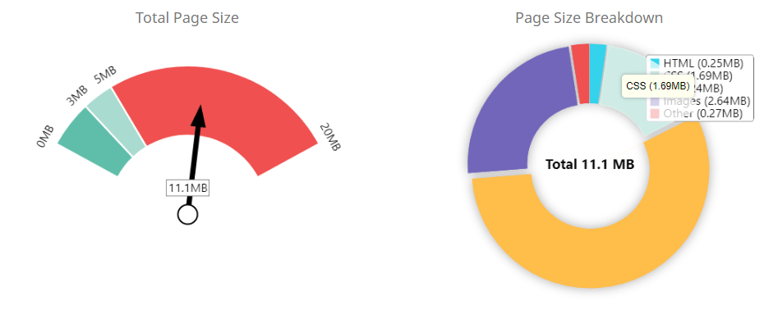
Initial Investigation
Check : Performance Results
Page Size Info
Your page's file size is quite large which, regardless of other optimizations, can reduce load speed and impact user experience.A general rule is to keep your page under 5MB in total file size.
Minification
Some of your JavaScript or CSS files do not appear to be minified.Minification is a reasonably simple way to reduce page size, and subsequently load time. Inline Styles
Your page appears to be using inline styles.Inline styles are an older coding practice and discouraged in favor of using CSS style sheets, due to their ability to degrade page load performance and unnecessarily complicate HTML Code.
Example:
578 | display: none;
588 | display:none;visibility:hidden
793 | margin-right: 5px;

